Slide 1



Anderson vs Anderson
Filmography vs Filmography

Slide 2
Paul Thomas Anderson
Releasing features since 1996
First feature was the film Hard Eight staring Philip Baker Hall, John C. Reily, and Gweneth Paltrow
Has released 9 features in total, with his tenth film, One Battle After Another, being released later this year
First notable success was Boogie Nights, his second feature released in 1997
His most successful project was There Will Be Blood staring Daniel Day-Lewis, a frequent collaborator, in 2007

Slide 3

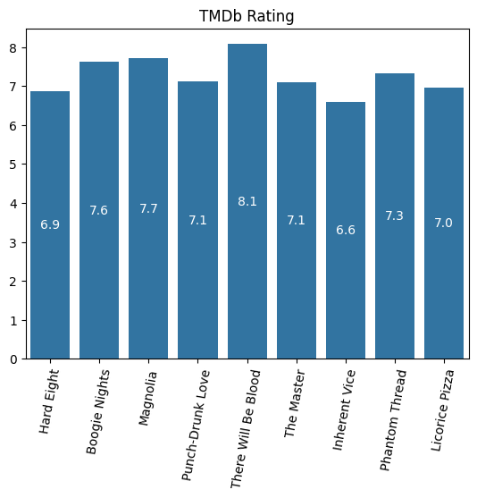

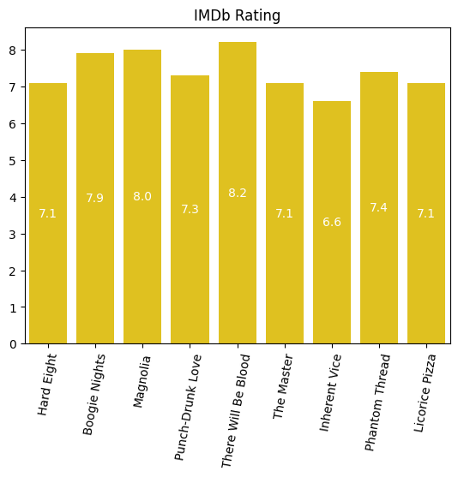
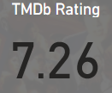
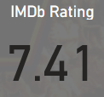
Paul Thomas Anderson

Slide 4
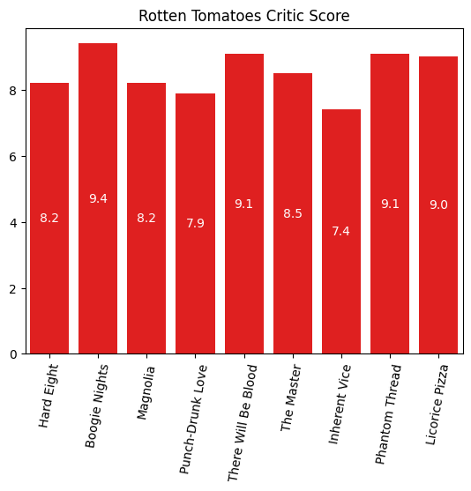

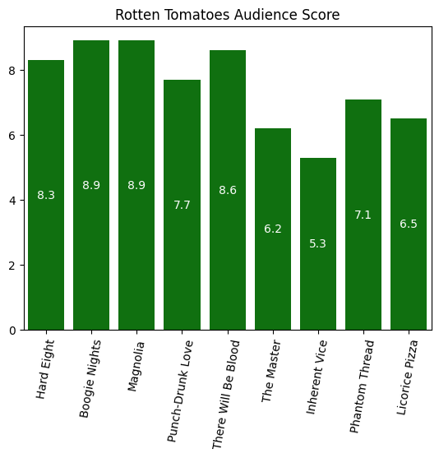
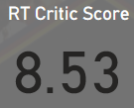
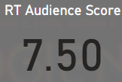
Paul Thomas Anderson

Slide 5
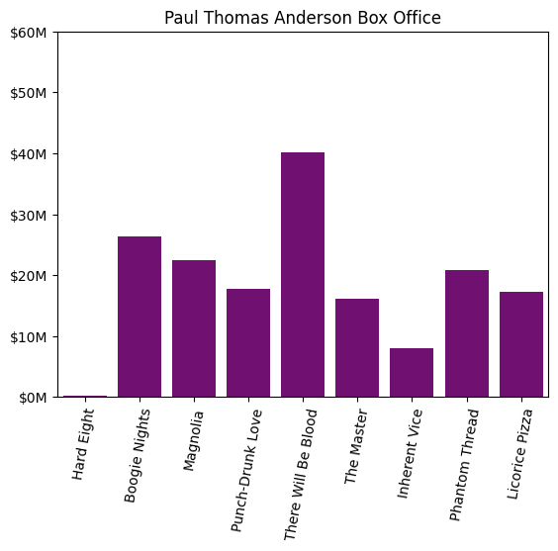
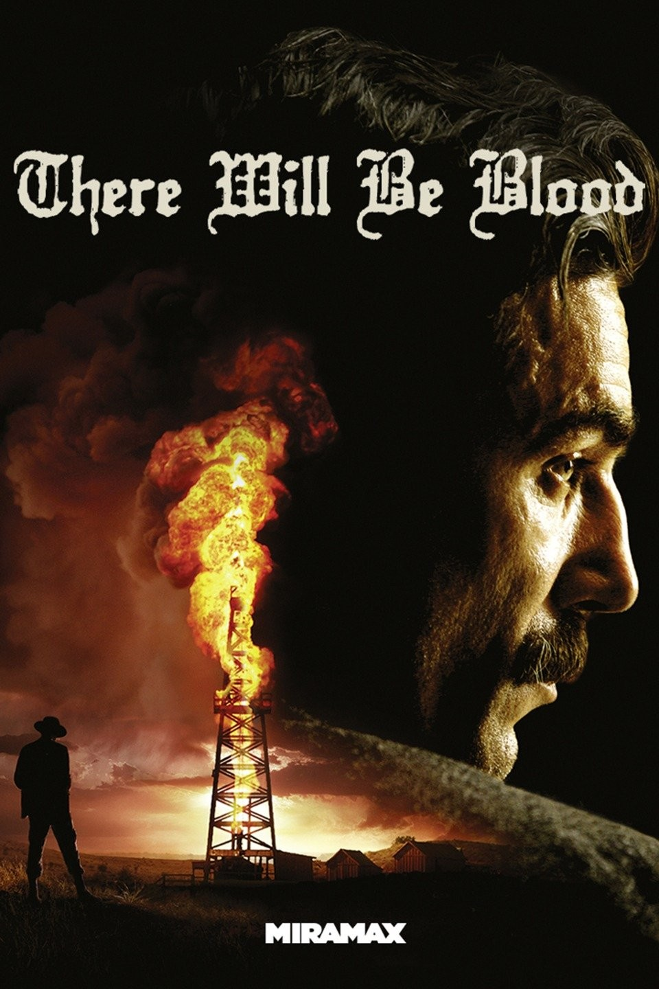
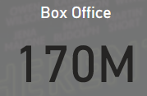
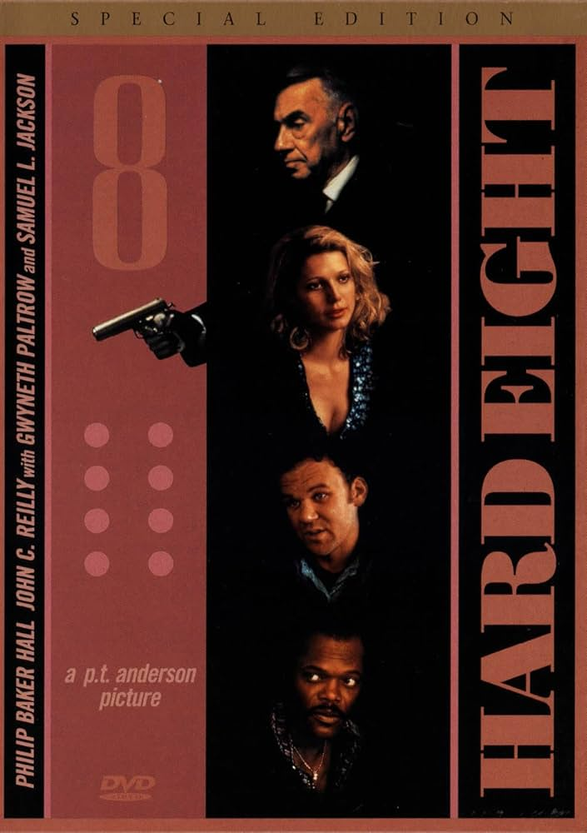
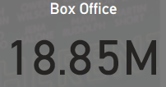
Paul Thomas Anderson

Slide 6
Wes Anderson
Began releasing feature films in 1996
First film was Bottle Rocket staring Luke and Owen Wilson
His first notable success was the 2001 film, The Royal Tenenbaums
His most successful film is The Grand Budapest Hotel which released in 2014

Slide 7
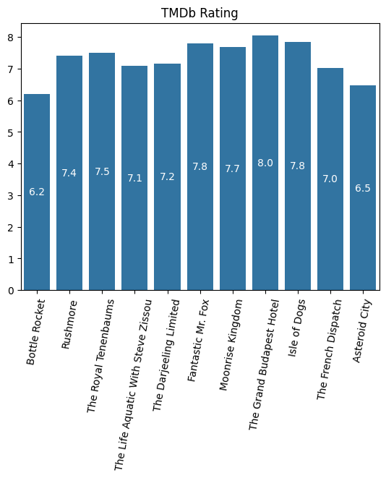
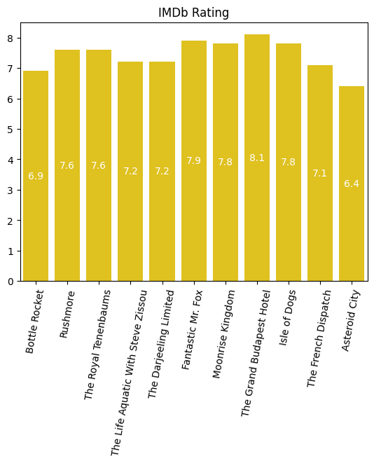
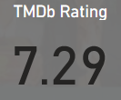
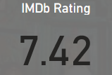
Wes Anderson

Slide 8
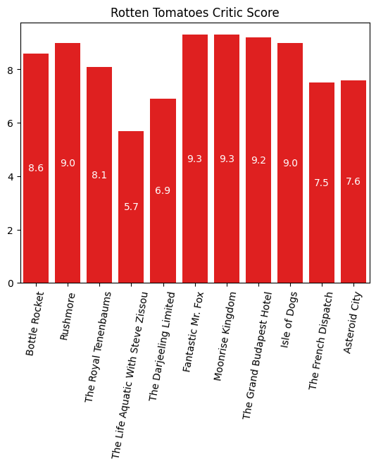
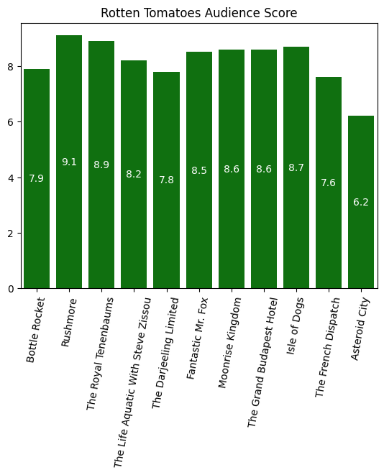
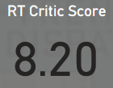
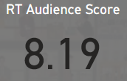
Wes Anderson

Slide 9
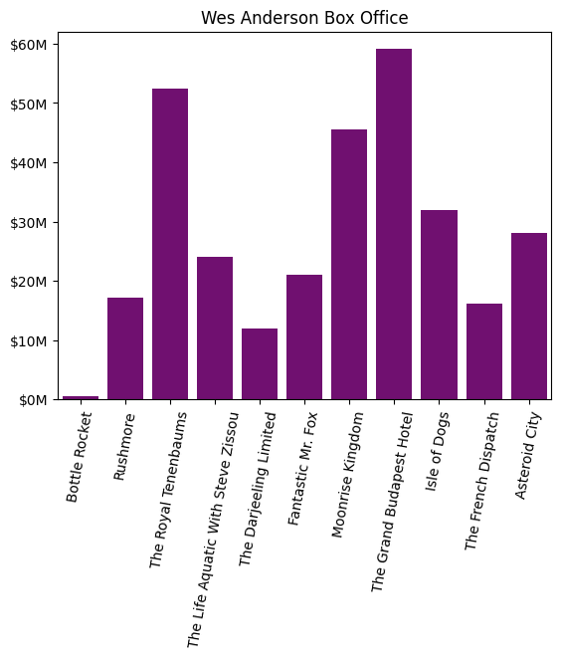

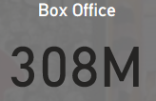

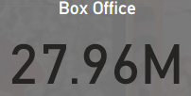
Wes Anderson
Notes:
Mention I am only focusing on the first 5 actors in the credits of each of his films in this data set.

Slide 10
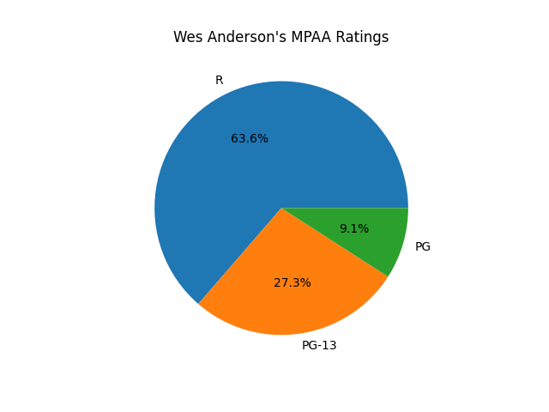
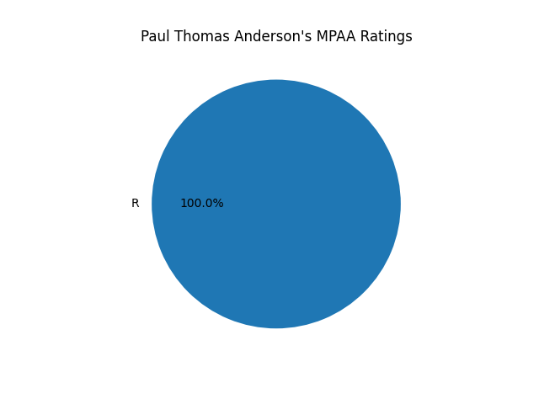
Anderson vs Anderson
Amount of Films
Nine versus Eleven

Slide 11
Anderson vs Anderson
Paul Thomas Anderson
Wes Anderson

Slide 12
Anderson vs Anderson
Paul Thomas Anderson
Wes Anderson

Slide 13
Anderson vs Anderson
Paul Thomas Anderson
Wes Anderson

Slide 14
Anderson vs Anderson
Paul Thomas Anderson
Wes Anderson

Slide 15
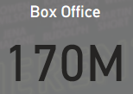
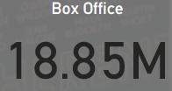
Anderson vs Anderson
Paul Thomas Anderson
Wes Anderson

Slide 16






Anderson vs Anderson

